Slide 1
Pallet Management System
Deep Trivedi – VELISHA FARMS

Slide 2
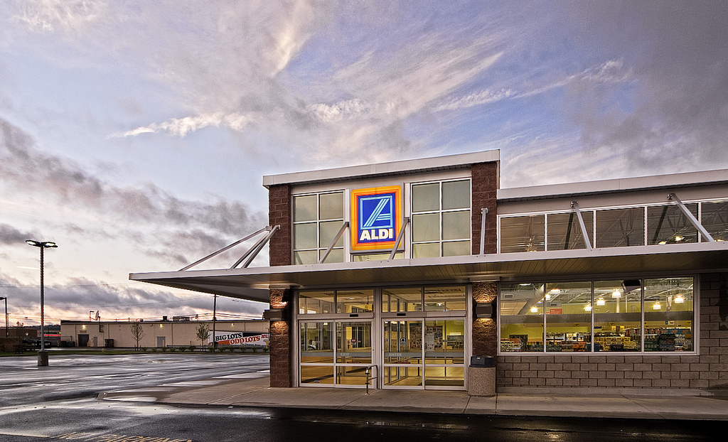
Aldi
Get the order
Calculate the amount of pallets
Make the order
Satisfy the customer
This Photo by Unknown Author is licensed under CC BY-NC-ND

Slide 3
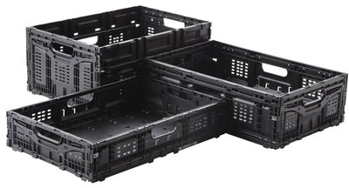
Crates – 48L, 34L, 22L
Product | Order
Broccoli | 80 | 16 x 5
Celery | 64 | 16 x 4
Lettuce | 100 | 20 x 5

Slide 4
Lifecycle
Get order
Start the production
Calculate the pallets
Then inform the truck company(Red Apple)
Make the order
Repeat
Aldi order
Trucks
Production
Make order

Slide 5
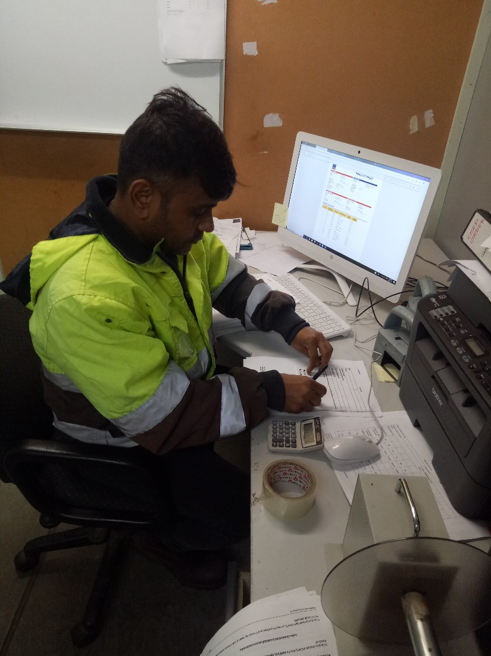
Calculation part
10 – 20 mins

Slide 6
Make the order via the system
Pros
Cons
Less time
No mistakes
Accurate data
Good impression for aldi
Great communication and understanding for the crew
Needs training and adjustment if needed

Slide 7
Thank You

